Slide 1
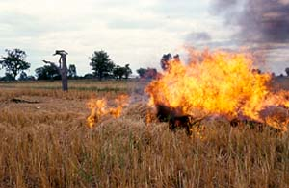
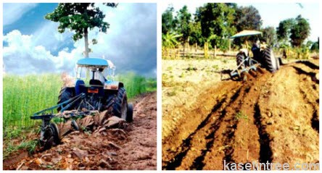
Thailand Country Report on Conservation Agriculture
by
Dr. Thongchai Tangpremsri
Notes:
1

Slide 2
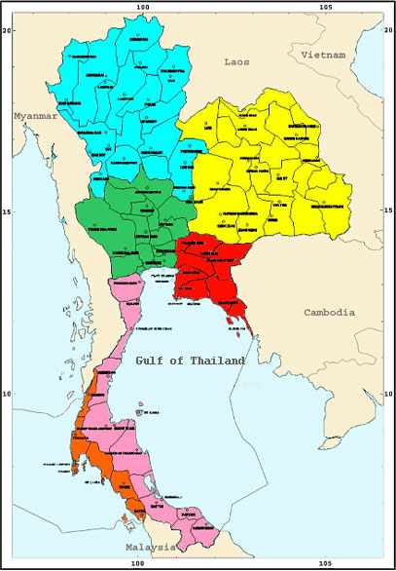
Thailand : food exporter. Total agri. areas are 23.8 m ha Rice: 11.2 m ha Rubber: 3.2 m ha sugarcane: 1.6 m ha cassava: 1.1 m ha maize: 1.0 m Ha

Slide 3
CA in Thailand
Introduction
Fluctuation in agricultural production important factors –soil degradation
Particularly in the northeast (poor soil and degraded)
Thai government managing the sustainable agriculture by CA

Slide 4
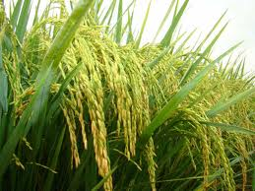
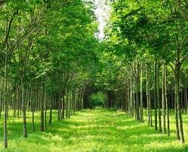
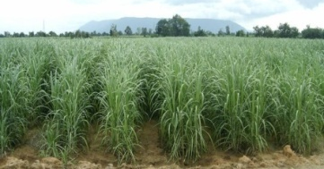
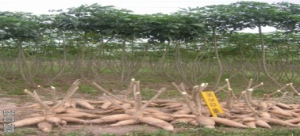
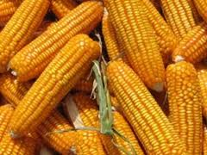
Case studies
1.Rice:
2.Rubber:
3.sugarcane:
4. cassava:
5.maize:

Slide 5
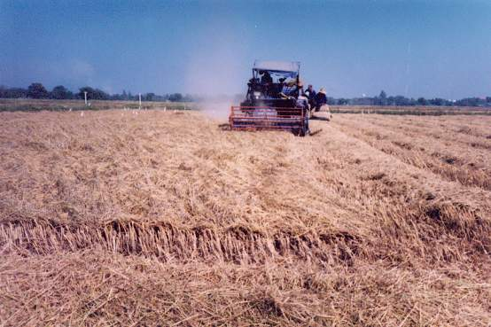
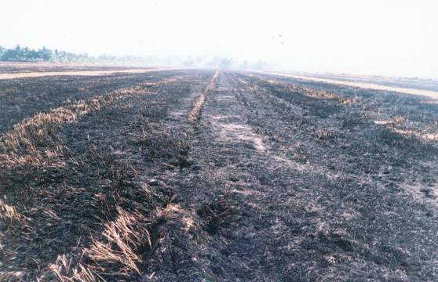
Rice: Conservation of rice straw and stubble
Past

Slide 6
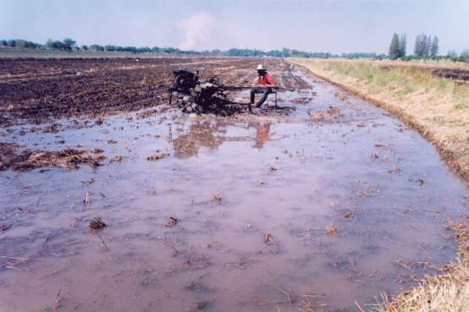
Rice: Conservation of rice straw and stubble
Present

Slide 7
Amount of rice straw and stump in various regions of Thailand (million tones)
Regions | Crop 1 |  | Crop 2 |  | Total
 | stubble | straw | stubble | straw
North | 2.80 | 4.24 | 0.12 | 0.19 | 7.36
Northeast | 9.03 | 13.61 | 0.11 | 0.18 | 22.93
Central | 3.32 | 5.01 | 0.79 | 1.20 | 10.32
South | 0.63 | 0.95 | 0.04 | 0.07 | 1.69
Total | 15.80 | 23.81 | 1.08 | 1.64 | 42.33

Slide 8
Rice: Conservation of rice straw and stump
Benefits of conserved rice straw and stubble on soil conditions.
1. Improving soil physical properties.
2. Improving soil chemical properties.
3. Improving soil biological properties

Slide 9
Rice: Conservation of rice straw and stubble
Losses and damages (burning)
1.Damage of soil structure: poor plant growth, weakness and vulnerable to diseases.
2. Loss of organic matter and plant nutritions.
3. Reduction of beneficial soil microorganisms.
4. Loss of soil water content.

Slide 10
Rubber : Cover crops in rubber tree plantation in the northeast
Biomass production and decomposition patterns
Two cover crop residues
Pueraria phaseoloides
Vertiveria zizanioides

Slide 11
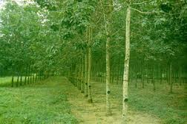
Rubber : Cover crops in rubber tree plantation in the northeast
Pueraria : short term - improve nutritions releasing nutrients into the soil from residues.
Vertiver: might reduce soil N at short and build up of the soil organic matter in the long term.

Slide 12
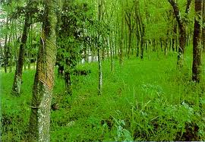
Rubber
Dry biomass of the two cover crops at cutting.
Crop cover Dry biomass produced (t/ha)
Upslope Midslope Downslope
Pueraria 1.96 (0.48) b 2.24 (0.20) b 2.71 (0.29) b
Vertiver 6.05 (2.01) a 5.59 (0.57) a 5.09 (0.52) a

Slide 13
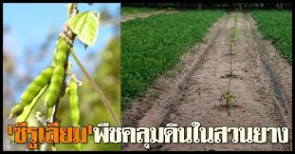
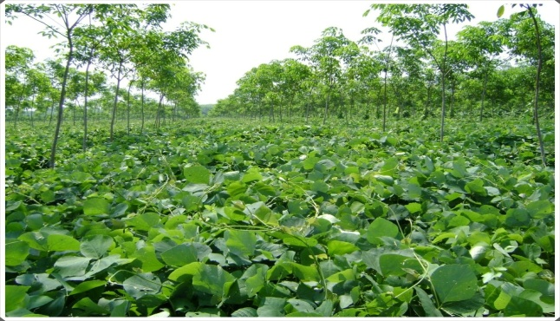
Rubber
Average initial chemical composition of two crop residues.
Residue C N C/N P K Ca Mg S
(%) (%) ratio (%) (%) (%) (%) (%)
Pueraria 45.07 3.18 14.3 0.19 2.15 0.82 0.21 0.17
Vertiver 51.77 0.79 65.8 0.06 1.54 0.24 0.08 0.08
Calopogonium Caeruleum

Slide 14
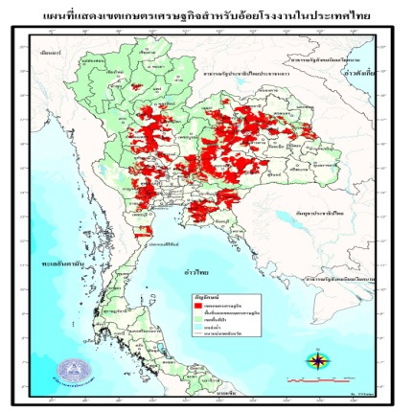
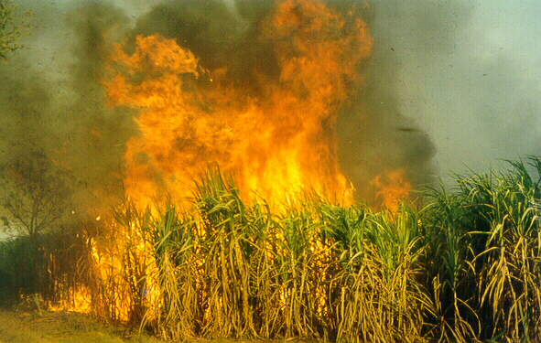
Sugarcane: Comparative analysis of different tillage systems used in sugarcane
Compare 5 tillage systems
Minimum tillage (the best)
-mechanical stool removal and machine planting
-best economic returns> conventional and no-till
: No-tillage; high savings ( non-use machinery)
but extra costs on herbicide use and extra labour

Slide 15
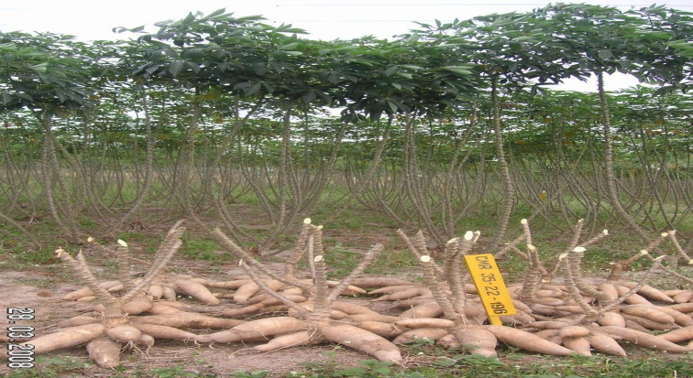
Cassava: Minimum tillage for cassava in Thailand
Develop no-tillage or minimum tillage
Conventional (3-disk plow , 7-disk plow)
- gave highest yields.
No tillage: low cassava yields
: improved the soil physic,
: increased porosity and soil hydraulic
conductivity
: reduced the bulk density

Slide 16
Cassava: Minimum tillage for cassava in Thailand
Land preparation treatments Fresh root yield (t/ha)
No-tillage 13.63 d
2 times with 7-disk plow 17.86 b
1time with 7-disk plow
followed by animal ridging 16.86 bc
2 times plowing with 3-disk plow,
followed by 7- disk plow 20.43 a
2 times of animal ridging 15.22 cd
1 time of subsoiler followed by 7-disk 15.54 cd

Slide 17
Maize: Manure application and No-tillage cultivation in Northeast Thailand
Manure and no-tillage regarded as techniques for carbon sequestration
( soil organic carbon )
Biomass of maize and weeds:
Conventional cultivation (stable)
Cattle manure (increased)
No-tillage (decreased)

Slide 18
Maize: Manure application and No-tillage cultivation in Northeast Thailand
Carbon balance:
1.Cattle manure increased the soil carbon stock and plant biomass and carbon input.
2.No-tillage : carbon loss by CO₂ flux was low.
3.Carbon input to the soil from maize residues and weeds was low.
4.Only a small amount of carbon input accumulated in the soil.

Slide 19
Thailand Main agricultural policy
1.Increase crop productivity through research and development and transfer technology.
2.Strengthen the grassroots farmer households, - increasing farming productivity
- reducing production costs
- systematic production system
3.Establish a farmer household registration system

Slide 20
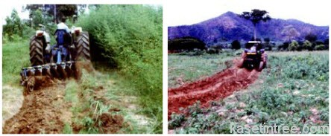
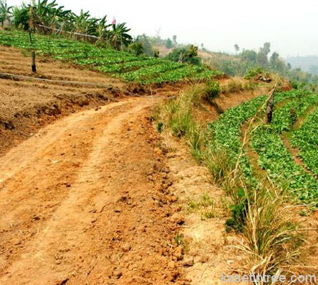
Conclusion:
Thailand is ready for conservation agriculture, particularly in the northeast region where the soil is so infertile and degraded.

