Slide 1
Conservation Agriculture in China
Li Hongwen
Changjiang Scholar, Professor, China Agricultural University (CAU)
Head, Conservation tillage Research Centre (CTRC), MOA

Slide 2
Conservation Tillage
≈
Conservation Agriculture

Slide 3
1. Background
Farm land:130 Mha
0.1 ha
Total Population: 1300 M
or
Farm land:130 Mha
0.16 ha
Rural Population: 800 M

Slide 4
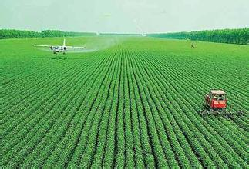
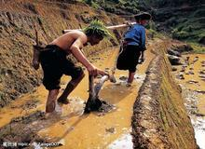
Big or Small？
1. Background

Slide 5
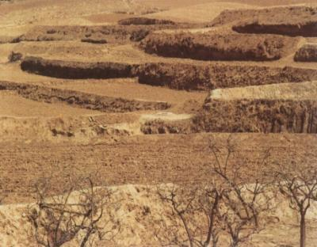
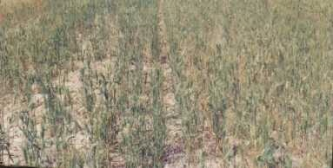
1. Background
Dry in 9 years of 10, in northern China

Slide 6
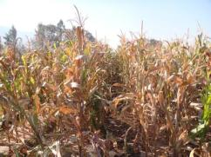
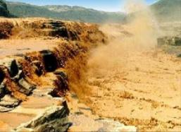
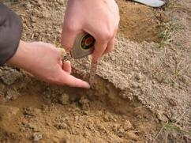
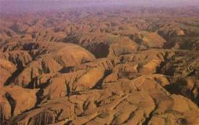
1. Background
No rain: Dry; Rain: Erosion

Slide 7
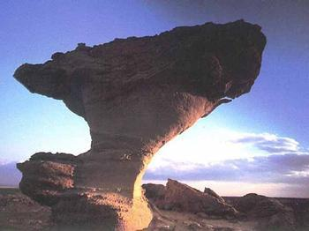
Wind Erosion
1. Background

Slide 8
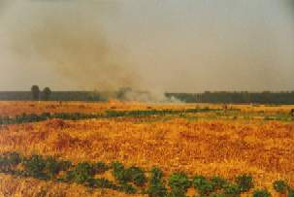
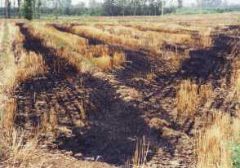
1. Background
Stubble Burning

Slide 9
2. Development of CA in China
CTRC
China
4th National S&T Award
MOA innovation Team
Review 10 years CA and Plan for future
2013
2012
MOA innovation Team
CA 20 years in China
2010
3rd National S&T Award
Start of CA Plan
2009
2nd National S&T Award
National CA Plan Approved
2002
1st National S&T Award
1st National S&T Award
1999
CTRC established
MOA supported CA
1992
Started CA, ACIAR
Started CA

Slide 10
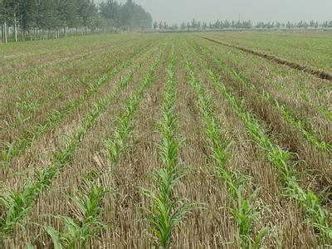
No till Experiment
(-1992)

Slide 11
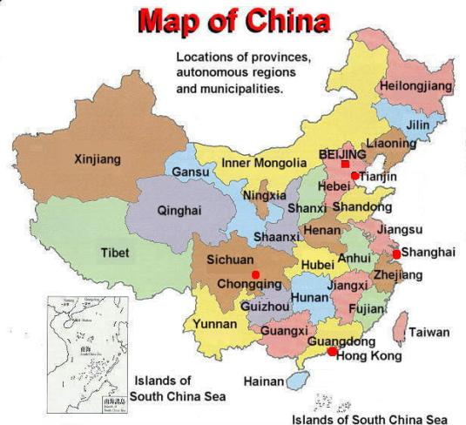
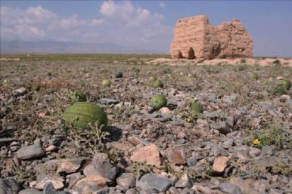
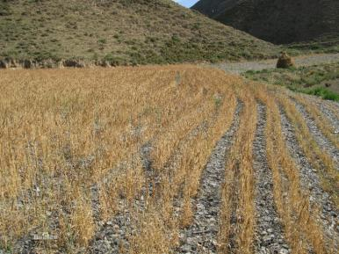
No Till Stone Field
From about 300 years ago

Slide 12
Age of no till in stone field
No Irrigation: no till last for 20-40 years
Irrigated: No till last for more than 6 years
Only used in certain area, can not be extended to other places

Slide 13
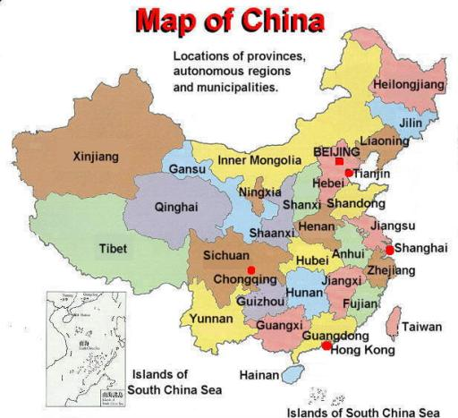
1950s No till wheat experiment
Heilongjiang

Slide 14
1960s: Natural no till in paddy area
Jiangsu
No till wheat broadcast after Rice
Sichuan
No till wheat broadcast after Rice

Slide 15
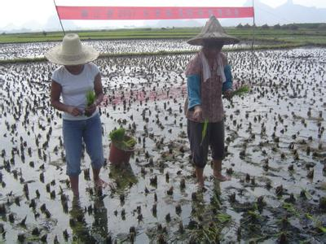
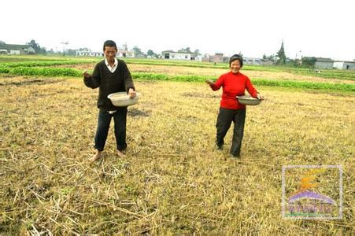

Slide 16
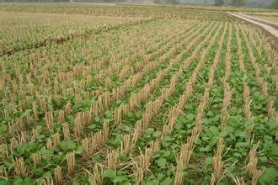
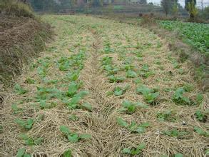
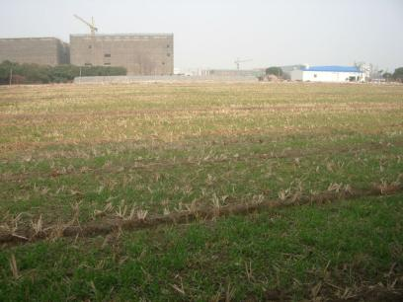

Slide 17
1980s No Till Maize Planting into Wheat
1970s: change from 3 crops 2 years, to 2 crops 1 year. Time limitation between 2 crops.
1980s: No till maize planting into wheat

Slide 18
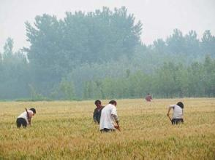
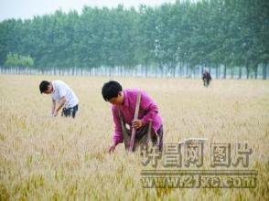
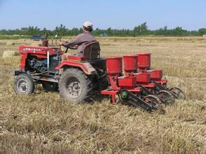
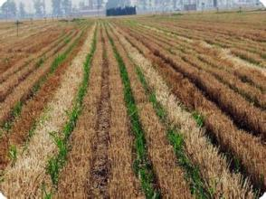
No till maize planting after wheat harvesting in June

Slide 19
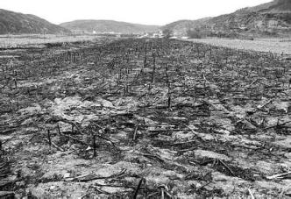
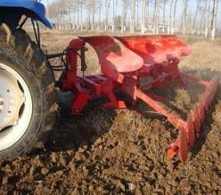
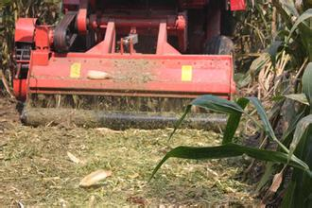
Field plough before wheat drilling in October

Slide 20
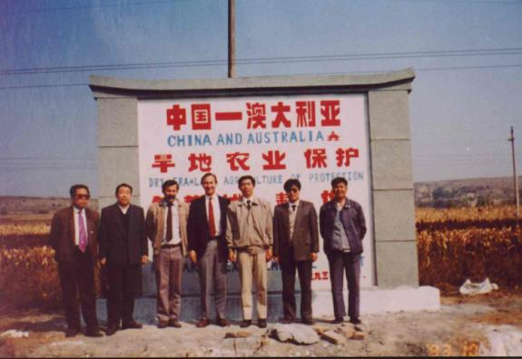
Conservation Tillage (1992-)

Slide 21
Stage 1 1992-2002
To Prove China Can Use Machinery to do Conservation Tillage
To Test Whether Mechanized Conservation Tillage Give Good Benefits.

Slide 22
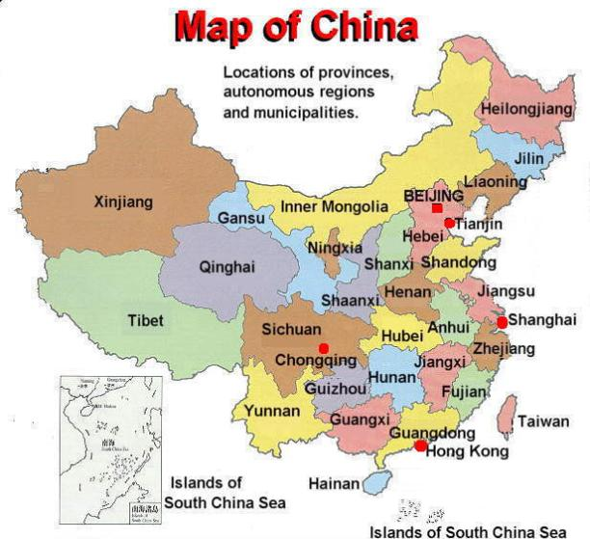
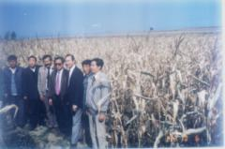
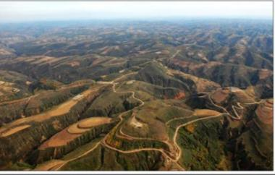
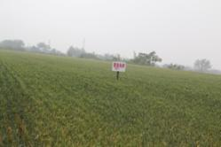
9 dry years of 10;
Water Erosion;
Wind erosion;
Variable yield;
……

Slide 23
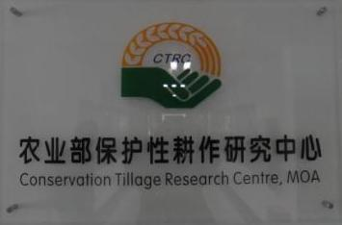
1999 CTRC Set up
Conservation Tillage Research Centre, Ministry of Agriculture,1999

Slide 24
Stage 2 Demonstration
All provinces, north of Yangtz River;
To Farmers
Show---build demonstration plots, to show what is conservation tillage, and what’s the result of conservation tillage, to give farmers direct viewing. Seeing is believing.

Slide 25
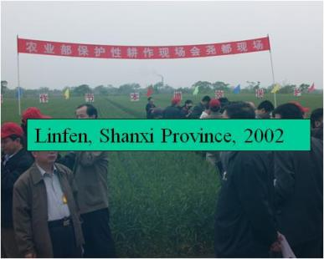
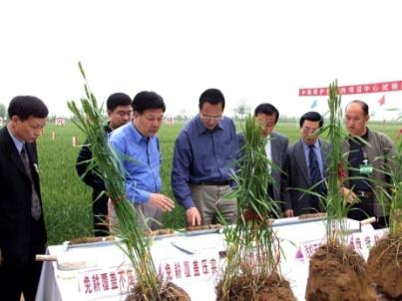
2002 The First National Field Meeting
Minister, provincial governor, scientists, extenders, etc

Slide 26
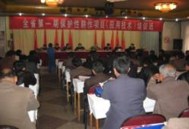
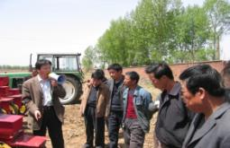
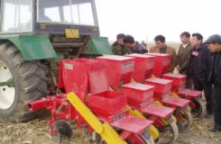

Slide 27
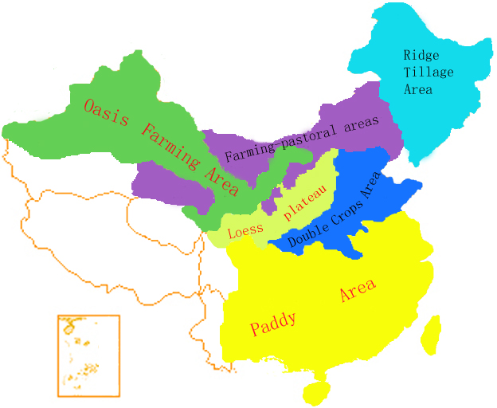

Slide 28
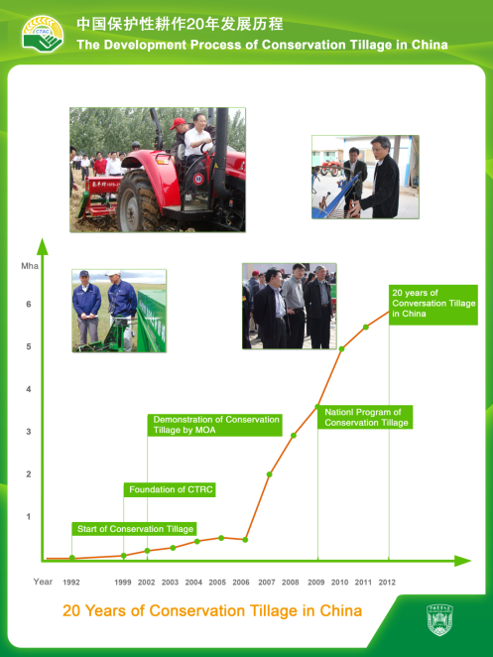
The area only refer to mechanized CA, not including that by hand and animal;
Among those area, about 20-30% is no till with stubble cover, most are minimum till with cover;
No till become more and more.

Slide 29
Machines and Tools
(more than 100 factories, different level)

Slide 30
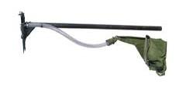
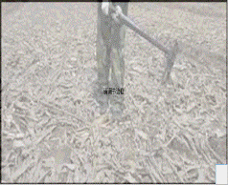
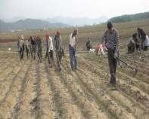
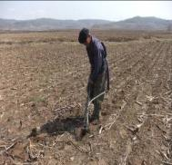
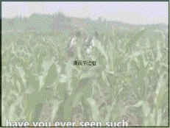
Hand Planter
Li Seeder 1

Slide 31
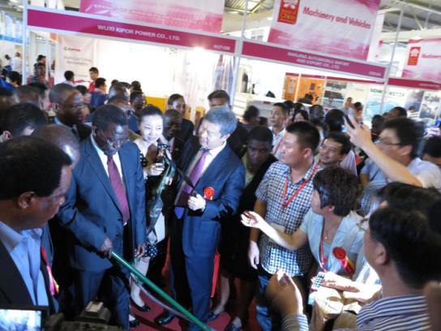
Premier of Tanzania Pinda is trying Li Seeder
Brands of China African Showcase 2013

Slide 32
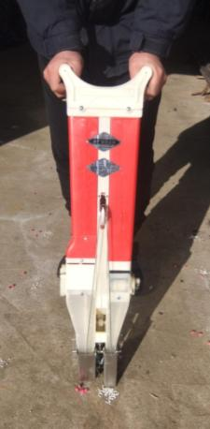
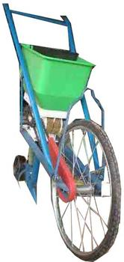
Li Seeder 2
Li Seeder 3

Slide 33
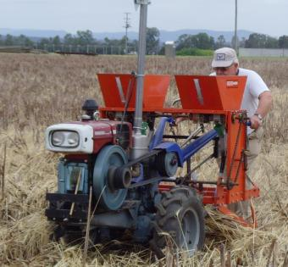
No till Seeder for 2 wheels tractor

Slide 35
Middle and Small No till Seeders

Slide 37
Wheat strip rotary hoe seeding

Slide 38
Rice strip rotary hoe transplanting

Slide 41
Benefits
Increase Yields;
Increase net income;
Reduced Cost
Reduce Soil Water Erosion
Reduce Soil Wind Erosion
Reduce Fuel Consumption
Reduce GHG Emission from Soil
……

Slide 42
Government Policy
The Central Document No.1 stressed CA fro 8 years, from 2005 to 2012.
The National Medium and Long Term Development Program (2006) included CA machineries as main parts of agricultural machineries.
Ministry of Finance supported MOA to extend CA from 2002.
The National Development and Reform Commission(NDRC) and MOA made a long term program for CA extension, and approved by the State Council (2009).
MOA made CA as a main extended technology.
White paper on China Environment Protection(1996-2005) lists CA as a main agricultural technology for agricultural environment protection.
China Water Saving Policy Program by Ministry of Water Resources (2005) encourage to extend CA.
Ministry of Forestry made CA a method for reducing wind erosion and soil desertification(2005).
China‘s climate change policy and action of the 2012 Annual Report, by NDRC, accepted CA as technology for carbon sink.

Slide 43
Barriers to adoption and promotion of CA
CA has been since 1940s? USA? Europe? Asia? There must be some deep barriers
Cheap and easy used CA machines.
Farmers traditional thoughts.
Some scientists do not accept CA, worry about yields, too much herbicide use. Some governmental officials have the same thought
……

Slide 44
Conservation Tillage
Research Center, MOA

Slide 46
中国保护性耕作网
www.cn-ct.net

Slide 47
Tasks 任务
Wind erosion
土壤风蚀
Yields
产量
Machine Development
研制机具
Water erosion
土壤水蚀
Cost
成本
Soil Moisture
土壤水分
Conservation Agriculture
实施保护性耕作
Weeds Control
杂草防除
Others
GHG Emission
温室气体排放

Slide 48
4 National Science & Technology Awards
2013

Slide 49
Recommendation
Establish ACAA?
(Asia CA Alliance or Cooperative Research Centre or Training Centre)
--- A Platform for CA information share in Asia

Slide 50
Field Trip
Why to Shandong? Long trip
Food?
What can be seen:
China high speed train, about 300km/h
CA machineries, and CA field.
Shandong Food , but fast food for breakfast and Supper .
为什么不排座位

Slide 53
All PPT and Doc files will be in a Flash Disk

Slide 54
Thanks
Thanks

